Slide 1
Capstone Project - The Battle of Neighborhoods

Slide 2
Introduction & Business Problem
Location selection is an important decision for businesses.
E.g., Stores that are difficult to visit will possibly lose their customers; by contrast, good store location will attract more new customers.
E.g., Good business location also play a crucial role in attracting and retaining best employees, such a location where employees can optimize work-life balance.
Good location decisions can significantly improve a company's long-term performance.
Problem 1: In Toronto, where is the most suitable place to open a restaurant?
Problem 2: In Toronto, where is the most suitable place for a contractor to setup their office?

Slide 3
Data acquisition and cleaning
Canada’s data (Postal codes, Borough, Neighborhood) are scraped from wikipedia: https://en.wikipedia.org/wiki/List_of_postal_codes_of_Canada:_M
In total, there are 103 rows and 3 features (Postal codes, Borough, Neighborhood)
Data cleaning: replace several terms for generalizing (e.g., ‘Downtown TorontoStn A PO Boxes25 The Esplanade‘ => 'Downtown Toronto Stn A')
Geo Spatial Dataset is from coursera: https://cf-courses-data.s3.us.cloud-object-storage.appdomain.cloud/IBMDeveloperSkillsNetwork-DS0701EN-SkillsNetwork/labs_v1/Geospatial_Coordinates.csv
Foursquare location data is applied

Slide 4
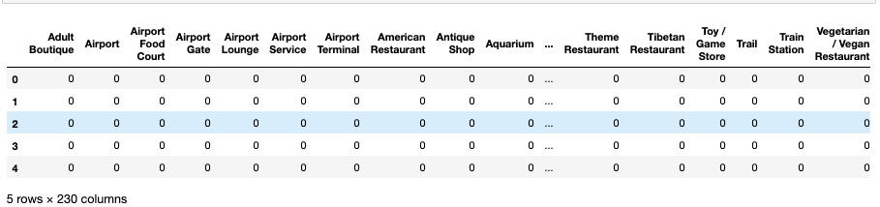
exploratory data analysis
How many venue categories in the dataframe ? => 230 categories

Slide 5

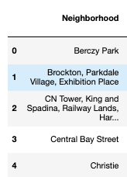
exploratory data analysis
How many ‘Neighborhood categories’ => results: 39
(examples of Neighborhood )

Slide 6
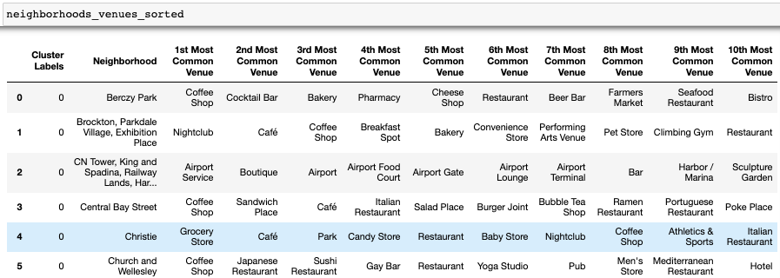
exploratory data analysis
Find the top 10 venues for each neighborhood

Slide 7
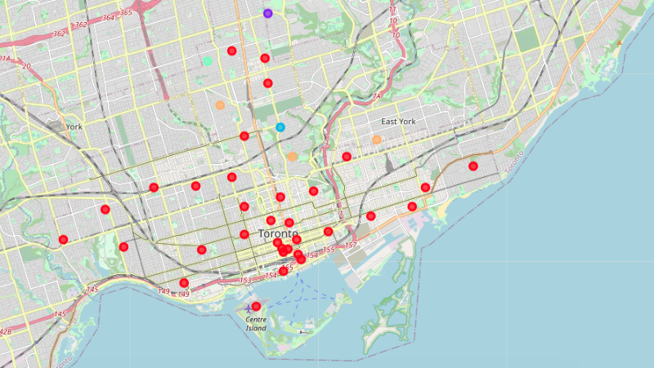
exploratory data analysis
Cluster Neighborhoods and mark them on a map

Slide 8
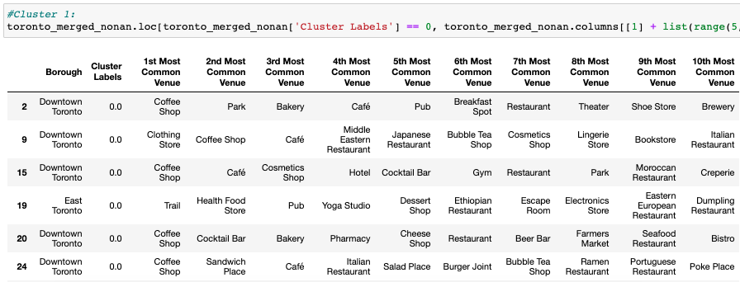
exploratory data analysis
Examine clusters (5 clusters): Cluster 1 (show few rows as an illustration)

Slide 9
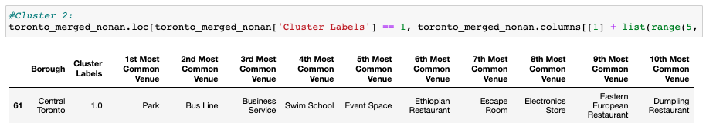
exploratory data analysis
Examine clusters (5 clusters): Cluster 2

Slide 10
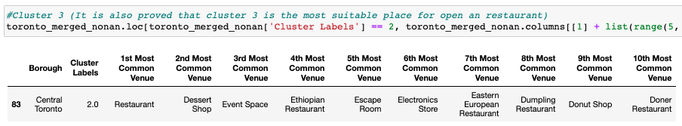
exploratory data analysis
Examine clusters (5 clusters): Cluster 3

Slide 11
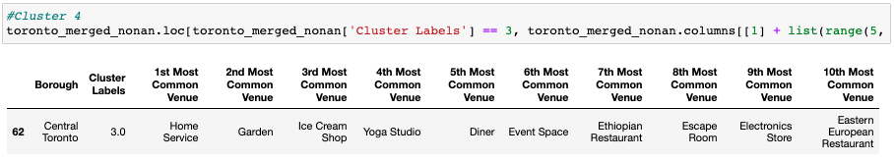
exploratory data analysis
Examine clusters (5 clusters): Cluster 4

Slide 12
exploratory data analysis
Examine clusters (5 clusters): Cluster 5

Slide 13
Results - Problem 1
Problem 1: In Toronto, where is the most suitable place to open a restaurant?
List neighborhoods and corresponding common venues (rank from top 1st to 10th )(see p.6 )
According to the results: My recommendation for opening an restaurant would be:
First priority: out of 10 top common venues, 5 are restaurants
=> Moore Park Summerhill East: top 1st, 4th , 7th , 8th , 10th (Also, see p.10, this location belongs to cluster 3)
Second priority: out of 10 top venues, 4 are restaurants
=> High Park, The Junction South (top 1st 3th , 9th , 10th) & Little Portugal Trinity (top 2nd , 3rd , 4th , 5th )

Slide 14
Results -Problem 2
Problem 2: In Toronto, where is the most suitable place for a contractor to setup their office?
I would recommed to set up an office in Lawrence Park: (also see p.9, it belongs to cluster 2 )
first reason: it is conveinent for commuting (top 2nd venue is Bus Line.)
Second reason: there are shops provide useful information ("Business Service" is the top 3 venues in this region), shops providing useful equipment (8th venue is Electronics store ), places that provide space for exhibitions ("Event space" ist the top 5 vanue)
Third reason:1st venue is Park and out of 10 top venues, there are three restaurant, so this region has a good environment (Parks allow people to optimize their work-life balance) and it is also convenient for dinings (Restaurant)

Slide 15
Conclusion and future directions
Clustering efficiency has room for improvement
It was not easy to identify the similarity of neighborhoods in one cluster; therefore, it took some time to decide the best place for opening a restaurant

